Slide 1
Secure Data Hiding in Image Using Steganography
CAPSTONE PROJECT
Presented By: ASHUTOSH KOTHIYAL
Student Name : ASHUTOSH KOTHIYAL
College Name : GRAPHIC ERA DEEMED TO BE UNIVERSITY, DEHRADUN, UTTARAKHAND
Department : Master of Computer Applications

Slide 2
OUTLINE
Problem Statement
Technology used
Wow factor
End users
Result
Conclusion
Git-hub Link
Future scope

Slide 3
Problem Statement
In today's digital world, secure communication is a major concern.
Traditional encryption methods can make messages look suspicious or noticeable.
There is a need for a way to hide sensitive information within images without raising suspicion.
Steganography provides a solution by embedding secret messages inside images, making communication more secure and undetectable.

Slide 4
Technology used
Programming Language: Python
Libraries Used:
OpenCV: For image processing
Tkinter: For the graphical user interface (GUI)
NumPy: For efficient pixel manipulation
PIL (Pillow): For image handling
Encryption Technique: Image-based steganography

Slide 5
Wow factors
The project enables users to hide messages inside images seamlessly.
No visible changes in the image after embedding the secret message.
Password protection ensures that only authorized users can decrypt the message.
Easy-to-use GUI-based application for non-technical users.
Supports custom message length handling for efficient decryption.

Slide 6
End users
Journalists & Activists: Secure communication in restrictive environments.
Government & Defence: Secure transmission of sensitive data.
Students & Researchers: Learning about cybersecurity and encryption.
Software Developers: Implementing steganography in security applications.
General Users: Protecting personal and confidential messages.

Slide 7
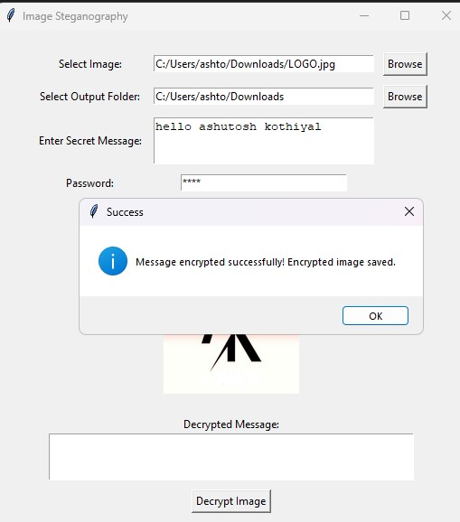
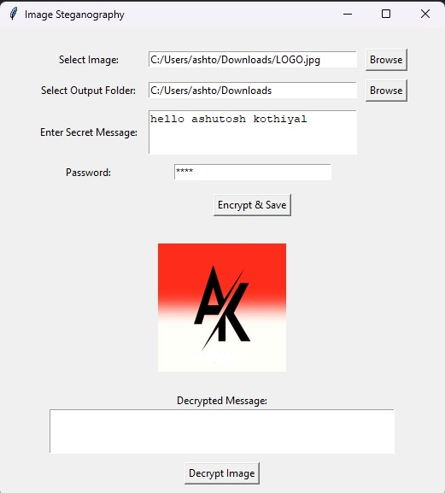
Results

Slide 8
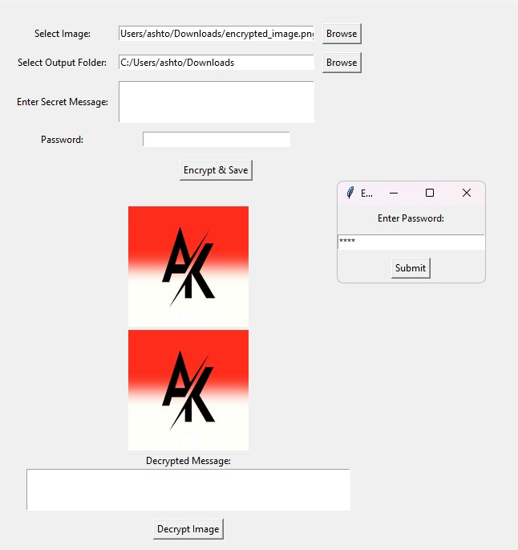
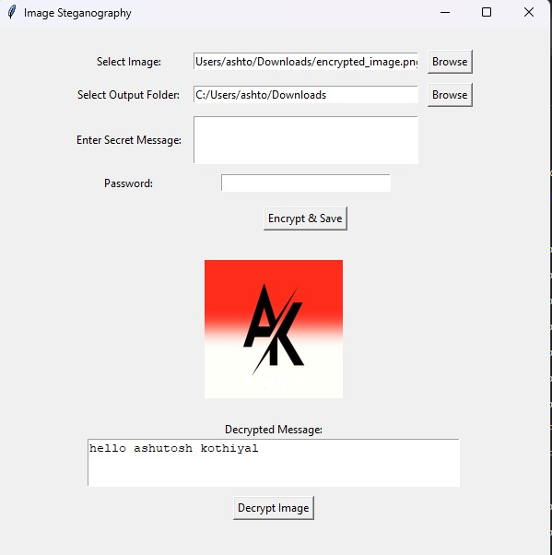
Results

Slide 9
Conclusion
This project demonstrates how steganography can be used for secure communication.
Image-based encryption ensures undetectable message transfer.
The implementation of password protection adds an extra layer of security.
The tool can be further enhanced for real-world security applications.

Slide 10
GitHub Link
GitHub:- https://github.com/Ashtosh007
Repository :- https://github.com/Ashtosh007/Steganography

Slide 11
Future scope(optional)
Support for multiple file formats (JPEG, BMP, etc.) for better flexibility.
Advanced encryption methods (AES + steganography for double security).
Mobile application integration for on-the-go secure communication.
Improved compression algorithms to maintain original image quality.
AI-based steganalysis resistance to prevent detection by automated systems.

Slide 12
THANK YOU

